Slide 1
Lecture 08: Conditional Statements

Slide 2
Objectives
Basic programming constructs
Sequence
Selection statements
'if' statements
Conditional/ternary/?: operator
Switch statement

Slide 3
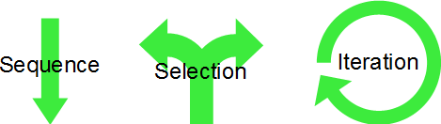
Basic Programming Constructs
Basic programming constructs are
Sequence, selection, and iteration (looping)
Sequence construct
Instructions are executed in the same order as they appear
Selection structure
Control flow can be changed by evaluating conditions
Iterative structure
A group of instructions is executed repeatedly
Until some condition is satisfied

Slide 4
Statements in C
Simple statement (expression statement)
It is terminated by a semicolon (;)
E.g., int a = 8;
Compound statements/blocks
Used to group statements into a single executable unit
Includes of one or more statements enclosed within {}
E.g. { int a = 10; int b = 11; int r = a+b; }

Slide 5
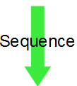
Sequence
A program, which consists of
Declaration statements
Input-output statements
One or more simple expression statements
int main(int argc, char *argv[]) {
// declare a variable of type string
char s[10]; // s cannot have more than 10 characters
// ask user to enter a name
printf("Enter a name: ");
// use gets to get a string from console
gets(s);
// print result:
printf("Here is a name: \n");
puts(s);
return 0;
}

Slide 6

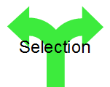
Selection/Conditional Statements
Used to alter normal flow of control
Provides ability to decide order of execution
Selection constructs in C are
“if” statement
Conditional/Ternary operator statement (? : )
“switch” statement

Slide 7
“if” Statement
Allows us to establish decision-making in the programs
Allow programs to test certain condition and make decision about which code block to be executed
The if statement has two basic forms
if-else
if-else if

Slide 8
Simple if-else
false
true
if (condition){
//one or more statements;
}
false
true
if (condition){
//one or more statements;
}else {
//one or more statements;
}

Slide 9
Example simple if example
void main()
{
int x;
printf(“Please input x: ");
scanf(“%d”, &x);
if(x > 10){
printf(”x is greater than 10");
} else {
printf(”x is smaller than or equal to 10");
}
}

Slide 10
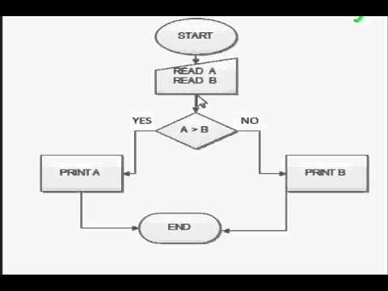
Activity: Find maximum
Create a program to
Ask user to input two integers
Find and display the larger one

Slide 11
if-else if ladder
The condition is evaluated sequentially
From the top of the ladder and moving downwards
if (condition){
//one or more statements;
}else if (condition) {
//one or more statements;
…
}else {
//one or more statements;
}

Slide 12
Example if-else if ladder
void main()
{
int x;
printf(“Enter your choice (1 - 3) : “);
scanf(“%d”, &x);
if (x == 1)
printf (“\nYour choice is one”);
else if ( x == 2)
printf (“\nYour choice is two”);
else if ( x == 3)
printf (“\nYour choice is three”);
else
printf (“\nInvalid choice“);
}

Slide 13
Activity: if-else if ladder
Make a program to find grade classification
Ask user to input a grade (ranging from 0 to 100)
If that grade is < 40 -> Fail
If that grade is >= 40 and < 50 -> 3rd class
If that grade is >= 50 and < 60 -> 2nd class 2nd division
If that grade is >= 60 and < 70 -> 2nd class 1st division
If that grade is >= 70 -> first class
And display corresponding message

Slide 14
Conditional/Ternary/? : Operator
This operator takes 3 expressions/operands
It is more efficient form for expressing simple if statement
General form
[variable = ] expr1 ? Expr2 : expr3
This simply states
if(expr1 is true) then expr2 else expr3
Where
expr2 is evaluated, if the value of expr1 is non-zero (true)
expr3 is evaluated, if the value of expr1 is zero (false)

Slide 15
Example ternary operator
void main()
{
int x;
printf(“Enter a number from 1 to 10: “);
scanf(“%d”, &x);
int result = (x >= 1 && x <= 10)? 1 : 0;
if(result){
printf(“Valid input“);
}else{
printf(“Invalid input“);
}
}

Slide 16
Activity
Make a program to
Ask user to input two integers
Find the larger one using Ternary operator

Slide 17
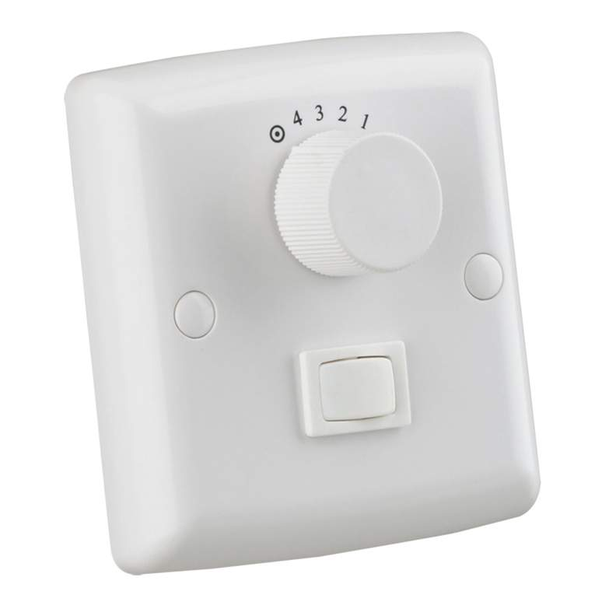
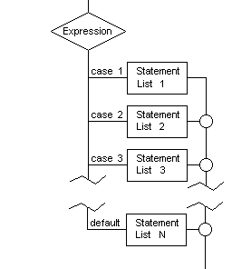
Switch Statements
Can be used in place of if-else-if statements
Used in situations where the expression being evaluated results in multiple values.

Slide 18
General form of Switch statement
switch(expression){
case item1:
//one or more statements;
break;
case item2:
//one or more statements;
break;
case itemn:
//one or more statements;
break;
default:
//one or more statements;
break;
}

Slide 19
Example switch statement
void main(){
int x;
printf(“Enter a number from 0 to 3: “);
scanf(“%d”, &x);
switch(expression){
case 0:
printf(“The fan is off“);
break;
case 1:
printf(“The fan is running with speed one“);
break;
case 2:
printf(“The fan is running with speed two“);
break;
case 3:
printf(“The fan is running with speed three“);
break;
default:
printf(“Invalid input“);
break;
}
}

Slide 20
Activity: Arithmetic operators
Make a program to
Ask user to input two numbers
Ask user to input one of these arithmetic operators represented by character (‘+’, ‘-’, ‘*’, ‘/’)
Display “invalid operator” if user inputs the wrong character
Else, display the corresponding result

Slide 21
Activity: vowels
Make a program to
Ask user to input a character
Display an error message if user inputs a non alphabet character (check with ASCII e.g., ‘a’ < c <‘z’ for lower case characters)
If the character is alphabet, check if it is a vowel (‘a’, ‘e’, ‘i’, ‘o’, ‘u’) or a consonant
Display the result

Slide 22
Summaries
Basic programming constructs
Sequence
Selection statements
'if' statements
Conditional/ternary/?: operator
Switch statement

